Slide 1

Stage 7 Aim Faster Course Designer: Eric Beerbaum
Aim Faster is a 22 round, 110 point Comstock Medium course. There are 11 IPSC targets. The best two hits per target will score. The start signal is audible.
The Handgun start position is standing anywhere outside the shooting area with wrists below belt. Handgun loaded and holstered. The PCC start position is standing anywhere outside the shooting area, PCC loaded, stock on belt.
On the audible start signal, engage all targets from within the shooting area.

Slide 2
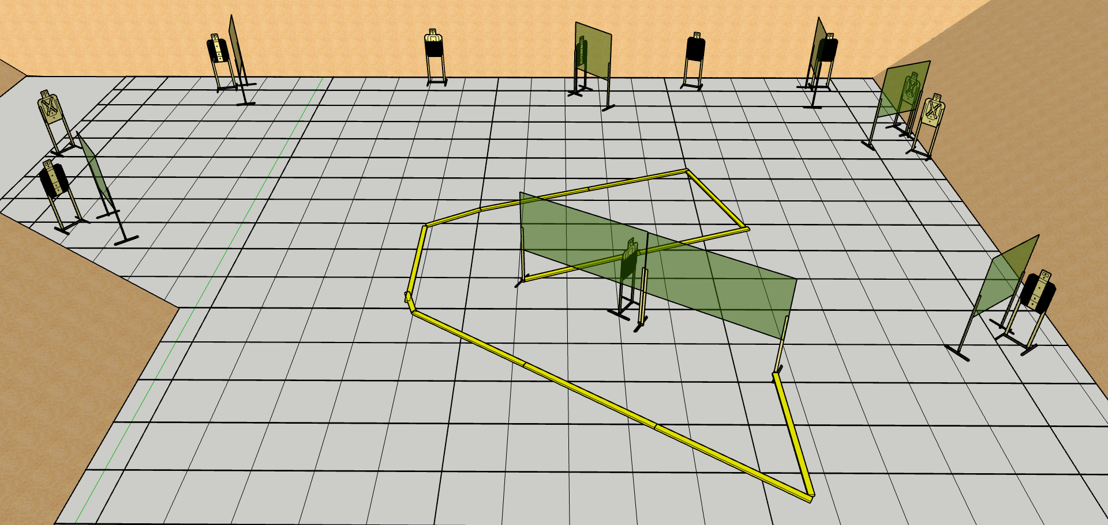
 | Stage 7 Aim Faster Course Designer: Eric Beerbaum

